Slide 1
Objectives of the Firm
1. Profit Maximization
2. Sales Maximization

Slide 2
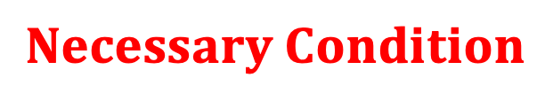




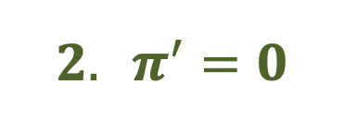
Profit Maximization (Marginal Method)
$$1. π=R −C$$
$$2. π^{′}=0$$
$$3. {R′ −C}^{′}=0$$
$$4. {R^{′}=C}^{′}$$
$$5. MR=MC$$
$$Necessary Condition$$

Slide 3
Profit Maximization (Marginal Method) – contd.
Perfect Competition
Imperfect Competition
MC
MC
Rev, Cost
Rev, Cost
E1
E1
E2
P
E2
MR
MR
Q1
Qty
Q1
Q2
Qty
Q2

Slide 4




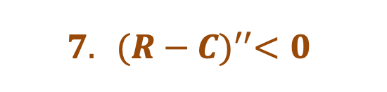

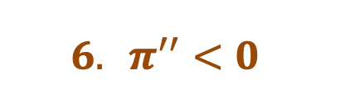
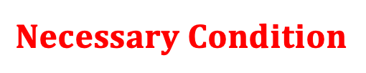
Profit Maximization (Marginal Method) – contd.
$$5. MR=MC$$
$$Necessary Condition$$
$$6. π^{′′}<0$$
$$7. {(R−C)}^{′′}<0$$
$$8. {(R′−C′)}^{′}<0$$
$$9. {MR′−MC}^{′}<0$$
$$10. s\left(MC\right)>s(MR)$$
$$Sufficient Condition$$

Slide 5
Profit Maximization (Marginal Method) – contd.
Perfect Competition
Imperfect Competition
MC
MC
Rev, Cost
Rev, Cost
E1
Stable
Equilibrium
Stable
Equilibrium
E1
E2 = E
E2 = E
P
MR
MR
Q1
Q2
Qty
Q1
Q2
Qty
At E1: $s\left(MC\right)<s(MR)$, Nec. C fulfilled but Suff. C. not fulfilled.
At E2: $s\left(MC\right)>s(MR)$, both, Nec. C. & Suff. C. fulfilled.

Slide 6
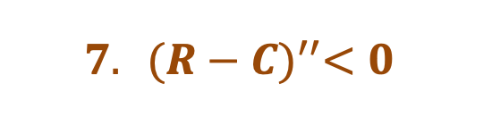


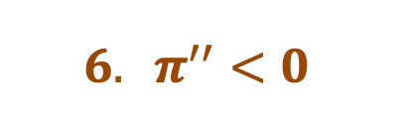
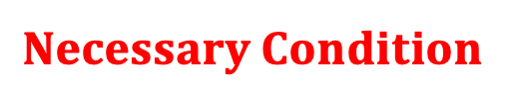







Profit Maximization (Recap of full Marginal Method) – contd.
$$Necessary Condition$$
$$Sufficient Condition$$
$$1. π=R −C$$
$$6. π^{′′}<0$$
$$2. π^{′}=0$$
$$7. {(R−C)}^{′′}<0$$
$$3. {R′ −C}^{′}=0$$
$$8. {(R′−C′)}^{′}<0$$
$$4. {R^{′}=C}^{′}$$
$$9. {MR′−MC}^{′}<0$$
$$5. MR=MC$$
$$10. s\left(MC\right)>s(MR)$$

Slide 7
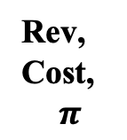

Profit Maximization, Break-Even Objectives : Perfect Competition (Total Method)
Rev, Cost,
$$π$$
TC
TR
B₂
Profit Max. at output OQ₂
R
V(Max Profit) = RC = MQ2
t_{C}
P_{B1} = P_{B2} = P_{R} = tan $∡$ B2OQ3
B₁
C
M
Q₁
Q₂
Q₃
Qty

Slide 8

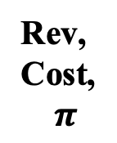

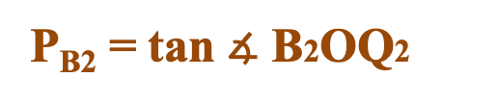
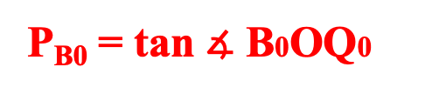

Profit Maximization, Break-Even Objective: Imperfect Competition
(Total Method)
Rev, Cost,
$$π$$
t_{R}
TC
B₂
R
TR
$$V\left(π max.\right)=RC=MQ_{1}$$
t_{C}
$$Q\left(π max.\right)=OQ_{1}$$
M
P_{R} = tan $∡$ ROQ1
B₀
C
P_{B0} = tan $∡$ B0OQ0
P_{B2} = tan $∡$ B2OQ2
Q₀
Q₁
Q₂
Qty

Slide 9
Profit Maximization, Break-Even Objective: Imperfect Competition (Total Method)
CONSTRUCTION SEQUENCE
Rev, Cost
t_{R}
TC
B₂
R
TR
t_{C}
M
B₀
C
Q₀
Q₁
Q₂
Qty

Slide 10
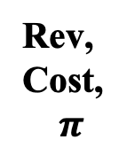
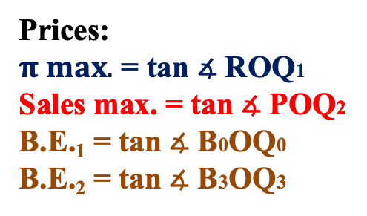
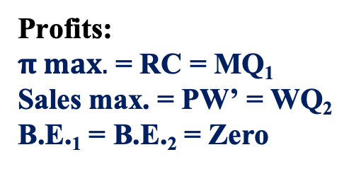
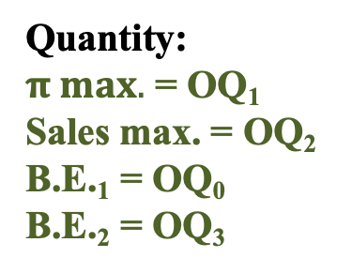
Profit Maximization, Sales Maximization, Break-Even Objectives: Imperfect Competition
For Sales Max.: R’ = MR = Zero
Quantity:
$π max.$ = OQ₁
Sales max. = OQ₂
B.E.₁ = OQ₀
B.E.₂ = OQ₃
Rev, Cost,
$$π$$
t_{R}
TC
P
B₃
R
TR
Profits:
$π max.$ = RC = MQ₁
Sales max. = PW’ = WQ₂
B.E.₁ = B.E.₂ = Zero
W’
t_{C}
M
B₀
C
W
Prices:
$π max.$ = tan $∡$ ROQ1
Sales max. = tan $∡$ POQ2
B.E.₁ = tan $∡$ B0OQ0
B.E.₂ = tan $∡$ B3OQ3
Q₀
Q₁
Q₂
Q₃
Qty

Slide 11
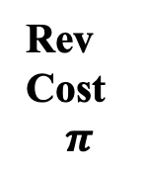
Sales Maximization Objective: Imperfect Competition
Rev Cost
$$π$$
Sales Max. output coincides with that of the 2nd Break-Even firm
TC
P
t_{R}
R
TR
t_{C}
B₀
C
M
Q₀
Q₁
Q₂
Qty

Slide 12
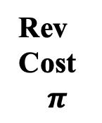
Rev Cost
$$π$$
Sales Maximization Objective: Imperfect Competition
T
TC
P
Sales Max. output leads to a loss
B₂
t_{R}
R
TR
t_{C}
B₁
C
M
Q₀
Q₁
Q₂
Q₃
Qty
W

Slide 13
Perfect Competition
Imperfect Competition
Rev, Cost
t_{R}
TC
TC
TR
Rev, Cost
P
B₂
R
TR
B₂
t_{C}
R
M
t_{C}
B₁
C
B₁
W
C
M
Q₁
Q₂
Q₃
Qty
Q₁
Q₂
Q₃
Q₄
Qty

Slide 14
Perfect Competition
(Product Market)

Slide 15
SHORT RUN DYNAMICS UNDER PERFECT COMPETITION

Slide 16
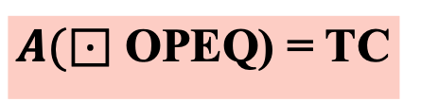
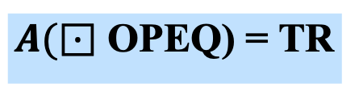

Perfect Competition
NORMAL PROFIT
Firm
Industry
Rev, Cost
Price
AC
MC
S
Ei
E
P
E
P
AR / MR
Ent.
profit
Entrepreneur’s
Profit
Interest
Interest
Rent
D
Rent
Wages
Wages
Q
Qd, Qs
Q
Qty
$A(⊡$ OPEQ) = TR
T($π)=ZERO$ as TR = TC
$A(⊡$ OPEQ) = TC

Slide 17
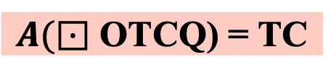
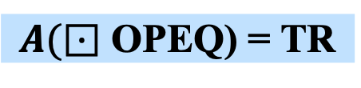
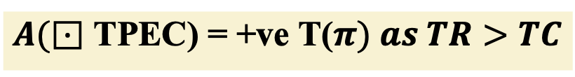
Perfect Competition.
SUPERNORMAL PROFIT
Industry
Rev, Cost
Firm
Price
MC
S
AC
Ei
P
P
E
AR / MR
Super-NP
T
C
Entrepreneur’s profit
Interest
D
Rent
Wages
Qd, Qs
Q
Qty
$A(⊡$ OPEQ) = TR
$A(⊡$ TPEC) = +ve T($π) as TR>TC$
$A(⊡$ OTCQ) = TC

Slide 18


Perfect Competition.
SUBNORMAL (Continue)
Firm
AC
AVC
Price
Industry
Rev, Cost
MC
S
T
C
Sub-NP
Ei
Entrepreneur’s
Profit
P
E
AR / MR
P
Interest
Rent
V
D
Wages
Qd, Qs
Q
Qty
$A(⊡$ OPEQ) = TR
$A(⊡$ TPEC) = - ve T($π) \left(as TR<TC \right) \& AR>AVC$
$A(⊡$ OTCQ) = TC

Slide 19
Loss-making firms to CONTINUE
Firm
AC
AVC
Rev, Cost
MC
MC
T
C
Sub-NP
P
E
AR / MR
AC
V
AVC
T
C
Q
Qty
Sub-NP
Uncovered CAPEX
AC = AVC + AFC
CQ = QV + VC
P
E
Covered CAPEX
OPEX
CAPEX
V
CQ =
(QV)
+
(VE + EC)
Covered
Covered
Uncovered
Covered OPEX
Partly Covered
Hence CONTINUE Production
Q

Slide 20



Perfect Competition.
SUBNORMAL (Shut Down)
AC
Industry
Firm
MC
AVC
Price
Rev, Cost
C
S
T
Sub-NP
Entrepreneur’s profit
Ei
V
P
AR / MR
P
Interest
E
Rent
D
Wages
Qd, Qs
Q
Qty
$A(⊡$ OPEQ) = TR
$A(⊡$ TPEC) = - ve T($π) as TR<TC$
$A(⊡$ OTCQ) = TC

Slide 21
Loss-making firms to SHUT DOWN
Rev, Cost
AC
AVC
MC
T
C
AC
Sub-NP
MC
AVC
P
V
E
AR / MR
T
C
Sub-NP
Uncovered CAPEX
Q
Qty
V
UnCovered OPEX
AC = AVC + AFC
P
E
CQ = QV + VC
OPEX
CAPEX
(VC)
Covered OPEX
CQ =
(QE + EV)
+
Covered
Uncovered
Fully Uncovered
Partly Covered
Q
Hence STOP Production

Slide 22
Firm 1
Sub NP - Shutdown
Firm 2
Sub NP - Continue
Firm 3
Normal Profit
Firm 4
Super NP
Industry
AC
AVC
AC
Rev, Cost
Price
Rev, Cost
Rev, Cost
Rev, Cost
LAC
MC
MC
AC
MC
MC
AC
S
AVC
AVC
AVC
T
C
Ei
V
T
C
AR / MR
P
E
P
E
P
E
P
E
P
T
C
V
V
V
D
Qd, Qs
Q
Qty
Q
Qty
Q
Qty
Q
Qty

Slide 23
PRODUCTION EFFICIENCY UNDER PERFECT COMPETITION

Slide 24
Derivation of a Firm's Supply Curve
Rev, Cost
Price
MC
AVC
S
E3
P3
S3
P3
AR3 / MR3
E2
P2
S2
P2
AR2 / MR2
E1
P1
S1
P1
AR1 / MR1
E0
P0
S0
P0
AR0 / MR0
Q0
Q1
Q2
Q3
Qty
Q0
Q1
Q2
Q3
Qs

Slide 25
Derivation of a Firm's Supply Curve
Rev, Cost
Price
MC
AVC
S
E3
P3
S3
P3
AR3 / MR3
P2
E2
P2
S2
AR2 / MR2
E1
P1
S1
P1
AR1 / MR1
Q1
Q2
Q3
Qty
Q1
Q2
Q3
Qs

Slide 26
Derivation of the industry's Supply curve EQUALLY EFFICIENT FIRMS
Firm A
Firm B
OQi = OQa + OQb + OQc
Firm C
Industry
SI
SA
SB
SC
Price
Price
Price
Price
P0
P0
P0
P0
Qa
Qty
Qb
Qty
Qc
Qty
Qi
Qty
(100)
Derivation of the industry's Supply curve UNEQUALLY EFFICIENT FIRMS
Firm A
Firm B
OQi = OQa + OQb + OQc
Firm C
Industry
SB
SC
Price
SA
Price
Price
Price
SI
P0
P0
P0
P0
Qa
Qty
Qb
Qty
Qc
Qty
Qi
Qty
(100)

Slide 27
Monopoly

Slide 28
Definition:
A Monopoly firm is a SINGLE SELLER situation, in which there are NO CLOSE SUBSTITUTE
T.I.N.A.
Features:
Single Seller (= single owner)
No close substitutes
Firm and industry are concurrent (= price maker and price taker)
The Mon. Firm cannot determine both: the Price as well as the Qty to be sold due to the constraint of the dd function
Nature of Edp: if prices are rising then RIE
if prices are falling then RE
6. Objectives: Profit Max; Sales Max; Breakeven ??

Slide 29
_{Price}
_{D}
D₁
P₁
_{T}
P₂
D₂
_{W}
_{D}
Q₁
Q₂
_{Qty}

Slide 30
Monopoly: Super-Normal Profit (short-run)
Rev, Cost
MC
AC
P
R
T
C
E
MR
AR
Q
Qty

Slide 31
Monopoly: Normal Profit (short-run)
Rev, Cost
MC
AC
R = C
P= T
E
MR
AR
Q
Qty

Slide 32
Monopoly: Sub-Normal Profit (short-run)
AC
Rev, Cost
MC
T
C
P
R
E
MR
AR
Q
Qty

Slide 33
Monopoly: short-run
Sub-NP
AC
R, C
R,
C
Super-NP
R, C
Normal Profits
MC
AC
MC
MC
AC
T
C
P
R
R = C
P
R
P = T
T
C
E
E
E
MR
AR
MR
AR
MR
AR
Q
Qty
Q
Qty
Q
Qty

Slide 34
Monopolistic Competition

Slide 35
Coined by E.H. Chamberlin (USA – early 1939)
It is a blending of :
Monopoly + Competition
Most practiced market format currently
‘Imperfect Competition’ put forth by Joan Robinson (UK, late 1939):

Slide 36
Monopolistic Competition
Collective
Commodity
Demand Curves
Number of
Sellers
Product Differentiation
aspirational
drives
and
Group Concept
Selling Cost
Constraining
Factors
Interdependence among Sellers
Competition
Strategies
D
D1
P
Different objectives & Pricing strategies possible
R
d
d1
Qty

Slide 37
MONOPOLISTIC COMPETITION - GROUP DYNAMICS
R1
R2
R3
R4
Price
D2
D1
R2
R1
R3
R4
d1
d2
Qty

Slide 38
MONOPOLISTIC COMPETITION (SHORT RUN) - SUPERNORMAL PROFITS
MC
Rev/Cost
AC
D
P
R
T
C
E
AR
= d
MR
Q
Output

Slide 39
Oligopoly Price Leadership Models

Slide 40
Shared Market
Dominant Firm
Price
R, C
SF
AC
MC
Es
A
P
S1
D1
P1
R
P1
C
T
C
E
P2
S2
AR
MR
D
Q
Qty
Qd, Qs

Slide 41
Dominant Firm’s Traits
1. Deep Pockets = cross financializing to support Sub-Normal Profits
2. Able to create entry barrier = IPR, Predatory Pricing
3. Able to sustain the feeding of large market sizes at 40 % of the total market
4. Capable of operating like a cartel by being price-leaders

Slide 42
Numericals

Slide 43
Breakeven: TR = TC, Pie = 0 AR = AC (Full Cost)
Starting Maths for numericals
Pie (Max): {MC = MR & MC’ > MR’} or {pie’ = 0 and pie’’ < 0}
Sales (Max): {TR’ = 0 and TR’’ < 0} or MR = 0
MC pricing : MC = AR
Optimum Output: {AC’ = 0 and AC’’ > 0} or MC = AC
Optimum output pricing: find Optimum Qty sub. the Qty in AR
Edp : (m)(Price /Qty) = A / {A – M} = (L Seg) / (U Seg)

Slide 44
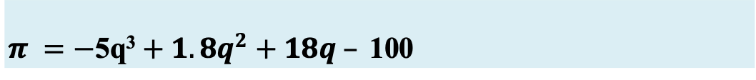
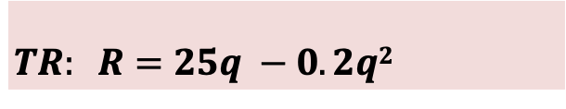

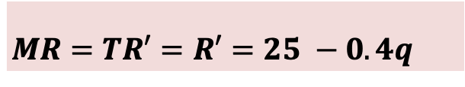
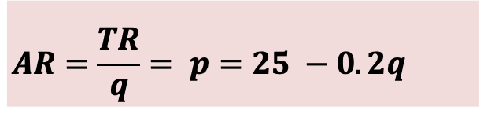
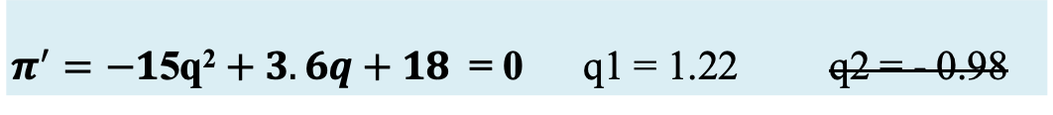

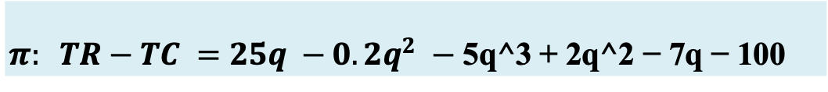
$$Pie status (via pie Max Principles)$$
$$TR: R=25q −0.2q2$$
C = 5q³ – 2q² + 7q + 100
$$AR=\frac{TR}{q}= p=25 −0.2q$$
AC = $\frac{TC}{q}=$ 5q² – 2q + 7 + $\frac{100}{q}$
$$MR=TR′=R′=25 −0.4q$$
MC = TC’ = 15q² – 4q + 7
$$π: TR−TC =25q −0.2q^{2} −\text{5}\text{q}\text{^3 + 2}\text{q}\text{^2 − 7}\text{q}\text{ − 100}$$
$$π =−\text{5}\text{q}\text{3}+1.8q^{2}+18q –\text{ 100 }$$
$π^{′}=−1\text{5}\text{q}\text{2}+3.6q+18 \text{ = 0}$ q1 = 1.22 q2 = - 0.98
$$V\left(π_{q=1.22}\right)=−1\text{5(1.22)}\text{2}+3.6\left(1.22\right)+18=Rs 0.066$$
$$P\left(q=1.22\right)=25 −0.2\left(1.22\right)=Rs 24. 76$$

Slide 45
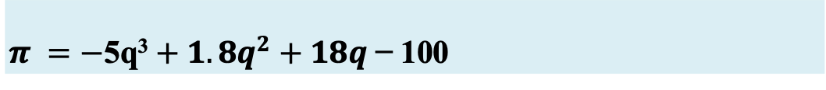

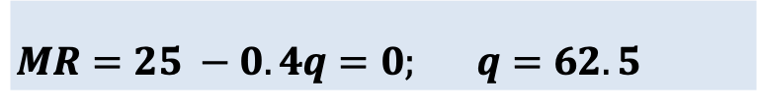
$$Pie status (via pie Max Principles)$$
$$TR: R=25q −0.2q2$$
C = 5q³ – 2q² + 7q + 100
$$AR=\frac{TR}{q}= p=25 −0.2q$$
AC = $\frac{TC}{q}=$ 5q² – 2q + 7 + $\frac{100}{q}$
$$MR=TR′=R′=25 −0.4q$$
MC = TC’ = 15q² – 4q + 7
$$π: TR−TC =25q −0.2q^{2} −\text{5}\text{q}\text{^3 + 2}\text{q}\text{^2 − 7}\text{q}\text{ − 100}$$
$$π =−\text{5}\text{q}\text{3}+1.8q^{2}+18q \text{− 100}$$
$π^{′}=−1\text{5}\text{q}\text{2}+3.6q+18 \text{ = 0}$ q1 = 1.22 q2 = - 0.98
$$MR=25 −0.4q=0; q=62.5$$
$$p=25 −0.2\left(62.5\right)=12.5$$
$π =−\text{5(62.5)}\text{3}+1.8{\left(62.5\right)}^{2}+18(62.5) \text{− 100 = −1147412}$

Slide 46




$$y= {7x}^{4}+{3x}^{3}−{2x}^{2}+10x+25$$
$$\frac{dy}{dx}= f^{′}= {28x}^{3}+{9x}^{2}−4x+10$$
$$f^{′′}= {84x}^{2}+18x−4$$
$$f^{′′′}=168x+18$$
$$f^{′′′′}=168$$

Slide 47
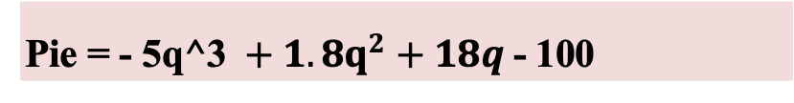
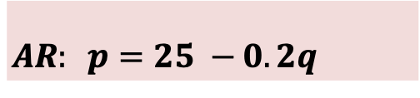
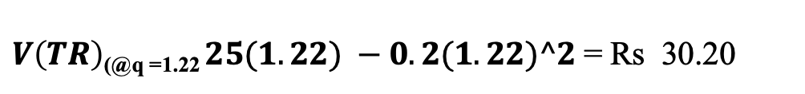

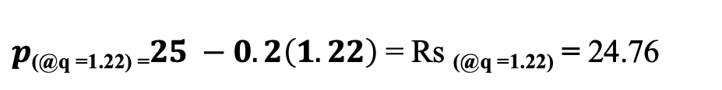

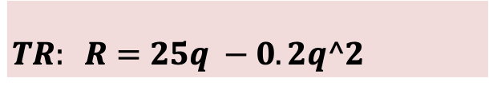
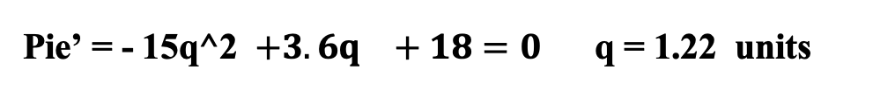
$$Pie status (via pie Max Principles)$$
$$TR: R=25q −0.2q^2$$
C = 5q^3 – 2q^2 + 7q + 100
$$AR: p=25 −0.2q$$
AC = 5q^2 – 2q + 7 + 100/q
$$MR: R′=25 −0.4q$$
MC = TC’ = 15q^2 – 4q + 7
Pie = $25q −0.2q^2$ - 5q^3 + 2q^2 - 7q - 100
Pie = - 5q^3 $+ 1.8q^{2}+18q$- 100
Pie’ = - 15q^2 $+3.6q^{}+18=0$ q = 1.22 units
V(Pie) _{(@q =1.22)} = - 5(1.22)^3 $+ 1.8{(1.22)}^{2}+18(1.22)$– 100 = Rs -84.44 Sub NP
$p\text{(@}\text{q}\text{ =1.22) =}25 −0.2\left(1.22\right)$= Rs _{(@q =1.22)} = 24.76
$V\left(TR\right)\text{(@}\text{q}\text{ =1.22} 25(1.22) −0.2(1.22)^2$= Rs 30.20
V(TC) $\text{(@}\text{q}\text{ =1.22)}$ 5(1.22)^3 – 2(1.22)^2 + 7(1.22) + 100 = Rs 114.64

Slide 48
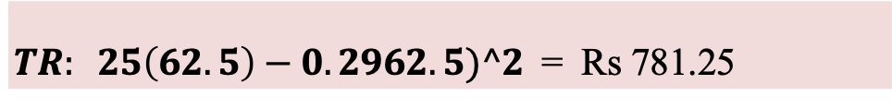
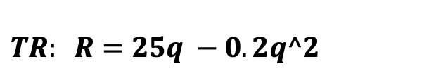
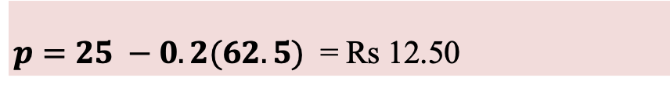

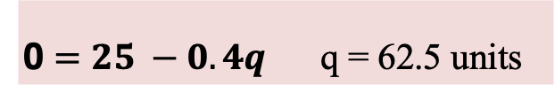


$$Sales max Numericals$$
$$TR: R=25q −0.2q^2$$
C = 5q^3 – 2q^2 + 7q +100
$$AR: p=25 −0.2q$$
AC = 5q^2 – 2q + 7 + 100/q
0 $=25 −0.4q$ q = 62.5 units
$$MR: R′=25 −0.4q$$
MC = TC’ = 15q^2 – 4q + 7
$p=25 −0.2(62.5)$ = Rs 12.50
$TR: 25\left(62.5\right)−0.2962.5)^2$= Rs 781.25
C = 5(62.5)^3 – 2(62.5)^2 + 7(62.5) + 100 = Rs 1213428.13

Slide 49
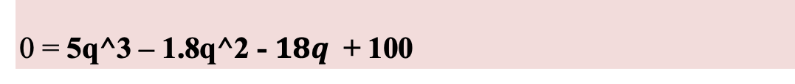
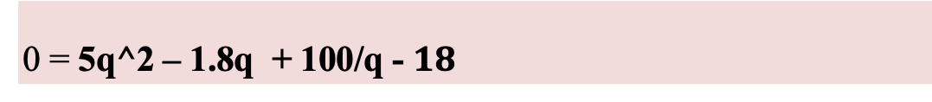

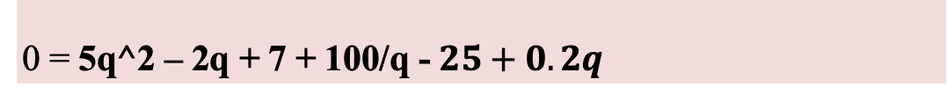
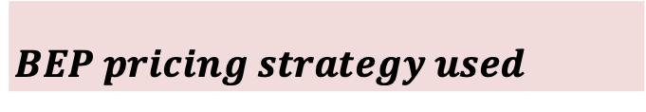
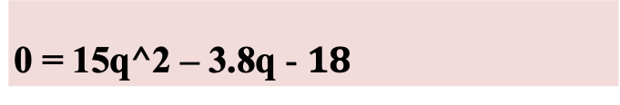

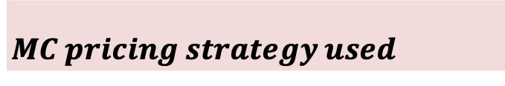
$Pricing strategies Numericals$: BEP, MC pricing
$$TR: R=25q −0.2q^2$$
C = 5q^3 – 2q^2 + 7q +100
$$AR: p=25 −0.2q$$
$$BEP pricing strategy used$$
AC = 5q^2 – 2q + 7 + 100/q
$$MR: R′=25 −0.4q$$
MC = TC’ = 15q^2 – 4q + 7
0 = 5q^2 – 2q + 7 + 100/q - $25+0.2q$
0 = 5q^2 – 1.8q + 100/q - $18$
0 = 5q^3 – 1.8q^2 - $18q$ + 100
Q1 = -ve
$$MC pricing strategy used$$
$\text{0 = 15}\text{q}\text{^2 – 3.8}\text{q}$- $18$

Slide 50
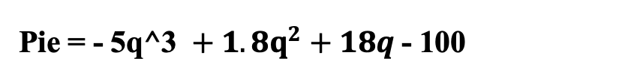
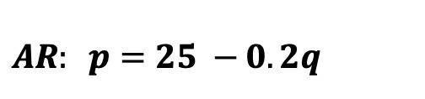


$Pricing strategies Numericals$: optimum qty pricing
$$TR: R=25q −0.2q^2$$
C = 5q^3 – 2q^2 + 7q +100
$$AR: p=25 −0.2q$$
AC = 5q^2 – 2q + 7 + 100/q
$$MR: R′=25 −0.4q$$
MC = TC’ = 15q^2 – 4q + 7
Pie = - 5q^3 $+ 1.8q^{2}+18q$- 100
AC’ = 10q – 2 - 100/(q^2) = 0 10q^3 – 2q^2 -100 = 0
Q = 2.19 units, NRN, NRN
Least Cost:
AC = 5(2.19)^2 – 2(2.19) + 7 + 100/(2.19) = Rs 72.26
Least Cost price:
$$p=25 −0.2\left(2.19\right)=Rs 24.56$$
Least Cost profit status:
Pie = - 5(2.19)^3 $+ 1.8{(2.19)}^{2}+18(2.19)$– 100 = Rs -104.46

Slide 51
$Elasticity Numericals$: A / (A – M) and {L Seg / U Seg}
$$TR: R=25q −0.2q^2$$
$$AR: p=25 −0.2q$$
$$MR: R′=25 −0.4q$$
Edp = 24.76 / [24.76 – 24.52] = RE
Cost price = Rs 42, the GST = 18%
market price = Rs (42 + 0.18*42) = 42+ 7.56 = Rs 49.56
Net Super NP = Rs 46050303 - 0.22*(4605030) – 0.02* 46050303 = 34998230.28
Value of Distributed pie = 34998230.28*0.25 = 8749557.57
Value of each dividend (1 lakh) = 87. 50

Slide 52
The Total Cost function of a firm is: C = (0.1)(q³) – 3q² + 50q + 100
Find the supply function of this firm
MC = 0.3q^2 – 6q + 50
C = (0.1)(q³) – 3q² + 50q + 100
TVC = 0.1q^3 - 3q^2 + 50q
C’ = (0.3)(q²) – 6q + 50
AVC = 0.1q^2 – 3q + 50
AVC = MC
0.1q^2 – 3q + 50 = 0.3q^2 – 6q + 50
0.1q^2 – 3q = 0.3q^2 – 6q
- 0.2q^2 = – 3q
- 0.2q = – 3
q = 15
The supply function of this firm is 0.3q^2 – 6q + 50 s.t. qty is at least =15 units OR the price should be at least Rs 27.5 (= Reservation Price)

Slide 53
Find the % changes in price & quantity when demand decreases & supply increases, given the following (shuffled) demand & supply functions:
p_{d1} = 100 - 0.3q_{d1}
p_{s1} = 60 + 0.7q_{s1}
p_{d2} = 180 - 0.3q_{d2}
p_{s2} = 40 + 0.7q_{s2}
p_{dNEW} = 100 - 0.3q_{d1}
p_{sOLD} = 60 + 0.7q_{s1}
p_{dOLD} = 180 - 0.3q_{d2}
p_{sNEW} = 40 + 0.7q_{s2}
p = 180 - 0.3q
p = 100 - 0.3q
% delta Q = - 50%
p = 60 + 0.7q
p = 40 + 0.7q
% delta P = - 43%
Q = 120, P = 144
Q = 60, P = 82

Slide 54
Key:
RED Eqn. = Original Data
PURPLE Eqn. = New Data
Price
Do
p_{s1} = 36 + 0.4q_{s1}
Dn
En
p_{s2} = 24 + 0.4q_{s2}
52
Pn
48
Po
Eo
Sn
p_{d1} = 90 - 0.7q_{d1}
p_{d2} = 80 - 0.7q_{d2}
So
Qn
Qo
Qd, Qs
40
60
 | Original | New | Change | %
Demand | p_{d1} = 90 - 0.7q_{d1} | p_{d2} = 80 - 0.7q_{d2} | xxx | xxx
Supply | p_{s2} = 24 + 0.4q_{s2} | p_{s1} = 36 + 0.4q_{s1} | xxx | xxx
Price | 48
Qty | 60
52
40
04
- 20
8.33
-33.3 %

Slide 55
p_{d1} = 90 - 1.7q_{d1}
p_{d2} = 120 - 0.7q_{d2}
DD = ?? & dd = ??
Price
BLUE EQN. = OBJECTIVE DD CURVE
brown eqn. = subjective dd curve
120
p_{d2} = 120 - 0.7q_{d2}
90
D
Objective / Market DD curve
d
Pe
R
p_{d1} = 90 - 1.7q_{d1}
d
Subjective / Individual dd curve
D
Qe
Qd, Qs
To find OPe and Oqe, solve the dd and DD equations simultaneously

Slide 56
TR: R = 30q – q²
TC: C = 3q^3 - 20q^2 + 2q + 50
Types of sums:
Profit Max principle:
status, qty, profit value, price charged
2. Sales Max: qty, profit value or status, price charged
3. Breakeven: qty, price(s) charged
4. Mkt Price = AR value + GST {25 + (0.18 x 25)}
5. Net Profit = Profit value – CIT (22%) – CSR (2%)
6. Regression: Trend line equation and CoD (R^2)
7. Elasticity
8. TPP, MPP, APP

Slide 57
TR: R = 30q – q²
TC: C = 3q^3 - 20q^2 + 2q + 50
AR: p = 30 – q
AC: c = 3q^2 - 20q + 2 + 50/q
MR: R’ = 30 – 2q
MC: C’ = 9q^2 – 40q + 2
Pie = -3q^3 + 19q^2 + 28q - 50
V(Pie) = 91.88
V(Pie) = 91.88 – 91.88*0.22 – 91.88*0.02 = Rs 69.83

